Slide 1




JGJJBBJBJ
APTELECOM
Capability Overview
OCTOBER 2024

Slide 2





Welcome to APTelecom
APTelecom specializes in developing connectivity and digital infrastructure in both established and emerging markets around the globe
For the past 15 years, APTelecom has been a trusted partner for building and optimizing digital infrastructure. We specialize in a comprehensive suite of solutions designed to empower your business, from high-performance connectivity to expert data center services. This capability deck dives deeper into our offerings, showcasing how APTelecom can be your one-stop shop for navigating the ever-evolving landscape of communication technology
SERVING THE
INDUSTRY
SINCE
2009
Copyright © 2024 APTelecom
Strictly Confidential

Slide 3



APTelecom: Your trusted partner
APTelecom assists clients to build and improve their networks, facilitate growth, and manage change
APTelecom is a global firm with seasoned telecommunications experts dedicated to providing strategic consulting, tailored advice, and comprehensive commercialization, feasibility and implementation support to our valued clients. Our team operates across the entire spectrum of the telecommunications business, including technical, commercial, and financial aspects.
For emerging subsea cable systems, APTelecom offers a unique advantage: insight and access to less traveled routes to market through our extensive network of relationships. This provides our clients with innovative and cost-effective solutions.
Copyright © 2024 APTelecom
Strictly Confidential

Slide 4

The APTelecom Advantage
01
02
03
Deep Experience
Strong Relationships
A Trusted partner
Broad and deep experience in the technical and financial aspects of building networks, and commercially, on both the buy and the sell sides of the business
Significant strong relationships of trust, worldwide across sectors, geographies and segments with proven capability of delivering results
A well-established reputation as a reliable and trusted provider, who has delivered across continents
Copyright © 2024 APTelecom
Strictly Confidential

Slide 5

Our Experience: Extensive Reach, Proven Deliverables
34
72
FIBER SYSTEMS
COUNTRIES
412
$420 Mn
800K
DATA CENTERS
SALES
ROUTE KILOMETERS
Copyright © 2024 APTelecom
Strictly Confidential

Slide 6








We offer a complete range of services
Connectivity
Satellite
Due Diligence
Artificial Intelligence
We pride ourselves on delivering qualified
pre-sales to planned subsea system builds and terrestrial networks
Market and business analysis, strategy, development and planning
A consulting partner to the private equity market providing comprehensive analysis that ensures maximum value is realized from every deal
Explore our global insights that look at how you can build confidence in AI, drive exponential value throughout your organization and deliver positive human impact
Data Center Services
Capacity Building
Analytics & Feasibility
Cloud
Determine the best direction to host IT services: in the cloud, in a co-location data center, or with a managed service provider
Bespoke course using a mix of presentations, in-depth case studies, and interactive exercises led by a core team of expert instructors with senior executive experience
A consulting partner to take your idea from the drawing board to reality
Our cloud services provide flexible, cost-effective, and reliable infrastructure for your business.
Copyright © 2024 APTelecom
Strictly Confidential

Slide 7


Our Global Business Practices
1
2
3
4
TELECOM CONSULTING
SUBMARINE CABLE DEVELOPMENT
CAPACITY
BUILDING
WHOLESALE TELECOM SERVICES
Providing expert Business and Technical support on telecommunications strategies and solutions, across geographies and segments including due diligence for M&A activities and business plan development
Feasibility, Pre-sales, Commercialization, Implementation and managing undersea cable systems for global connectivity
Providing training, development, and support to enhance the skills and capabilities on various Digital Infrastructure avenues
Offering Wholesale telecommunications services to other service providers and carriers
Copyright © 2024 APTelecom
Strictly Confidential

Slide 8









We offer Specialized services for Submarine Cables
Business Viability
Permits and licenses
Our undersea cable expert team offers extensive expertise in commercialization and implementation
Sales (Pre- and Post-RFS)
Feasibility Studies
Pricing and Market Fit
Vendor RFP and Selection
Financial Modelling
Cable System Implementation
Copyright © 2024 APTelecom
Strictly Confidential

Slide 9



Submarine Cable Solutions:
Market entry and Feasibility study
01
02
03
Business Viability
Technical Evaluation
Legal and Permitting Support
Evaluating demand, competition, and potential revenue streams and Identifying and mitigating potential risks and challenges. Business plan development and financial modelling
Determining the optimal cable route based on geographical factors and technical considerations. Evaluating the system's capacity, reliability, and latency requirements.
Ensuring adherence to local, national, and international regulations. Understanding the necessary permits and licenses from relevant authorities.
Copyright © 2024 APTelecom
Strictly Confidential

Slide 10

Submarine Cable Solutions:
Sales and Revenue Generation
04
05
06
Pricing and Market Fit
Sales (Pre- and Post-RFS)
Network Partnerships
Analyzing market demand, competitor pricing, and customer preferences. Identifying the target market segments and tailoring the cable offering to meet their specific needs.
Generating interest and securing commitments from potential customers before the cable system is ready for service (RFS) and beyond. Building strong relationships with customers to ensure long-term loyalty and satisfaction.
Forming partnerships with other cable operators, internet service providers, and content providers. Expanding the network's reach and connectivity by partnering with international carriers.
Copyright © 2024 APTelecom
Strictly Confidential

Slide 11

Submarine Cable Solutions:
Project Management and Delivery
07
08
09
Vendor RFP and Selection
Vendor Adjudication
Cable Implementation
Working closely with the customer to define their specific requirements and develop a detailed request for proposals (RFP). Selecting the most suitable vendor to meet the customer's needs and project objectives.
Overseeing the negotiation of contracts with the selected vendor, ensuring that all terms and conditions are favorable to the customer. Resolving any conflicts or disputes that may arise between the customer and the vendor.
Working closely with the customer and the vendor to coordinate all aspects of the cable implementation process. Overseeing the installation of the submarine cable, including laying the cable on the seabed and connecting it to landing stations.
Copyright © 2024 APTelecom
Strictly Confidential

Slide 12






Due Diligence
Country market and regulatory reports
We offer multiple services for Global Consultancy Firms
Business modelling, including pricing forecasts
Asset Monetization
Leveraging combined expertise to deliver comprehensive services to consultancy firms.
Market Strategies
Viability of new routes
Copyright © 2024 APTelecom
Strictly Confidential

Slide 13


Our Collaborative Solutions for Telco Success
Experienced subsea cable sales staff and a globally deployed international wholesale sales team
Expertise in all aspects of the commercialization of new builds
Monetization of existing international telecoms assets
As a de-facto Telco Wholesale ‘vertical’
Copyright © 2024 APTelecom
Strictly Confidential

Slide 14

Our Reach: Global Presence, Local expertise
Operations across US, Europe, Latam, Asia, Middle East and Africa
SERVED CLIENTS IN MORE THAN
25
COUNTRIES
Our clients are across continents
Multiple strategic partnerships with local providers
ANGOLA
AUSTRALIA
BRUNEI
BANGLADESH
CAMBODIA
Multi Lingual staff in Regions
CANADA
CARRIBEAN
CHILE
EQUADOR
FRANCE
GUAM
HAWAII
HONGKONG
INDIA
INDONESIA
IRELAND
JAPAN
KENYA
MALAYSIA
NORWAY
SOUTH AFRICA
THAILAND
UAE
UK
USA
Copyright © 2024 APTelecom
Strictly Confidential

Slide 15




The track record of the team
Implemented and Commercialized
PACIFIC CROSSING 1
PACIFIC CROSSING 2
TASMAN 1
APNG 1
ANZCAN
AIS
JASURUS
PACRIM EAST
TASMAN 2
PACRIM WEST
ATISA
TONGA CABLE
APNG 2
HONOTUA
ASH
SAS
TUISAMOA
SCCN
SMW3
AJC
Commercialized
AEC-1
WACS
SACS
MONET
MCT
MENA
SEA-US
HAWAIKI
HAVFRUE
ATISA
Copyright © 2024 APTelecom
Strictly Confidential

Slide 16


Proven Results across geographies and sectors
Subsea Presales
Subsea Consultancy
AUSTRALIA SINGAPORE CABLE
AQUACOMMS
BRUNEI INTERNATIONAL
TE SUBCOM
HIBERNIA
ALTMAN VALANDRIE
ANGOLA CABLES
DOCOMO
MENA
COLT
WIOCC
HAWAIKI
HAWAIIN TELECOM
EZECOM
FRANCE IX
TRANS INDONESIA
CDNet
DEEP BLUE CABLE
SING CABLE
STRATANET
TPN
MY US
CPC
SuperSistem
VOCUS
JAWS
EQUINIX
BULK
MAPLE LEAF
BTI
CONFLUENCE
ACC-1
Satellite Consultancy
Due Diligence Consultancy
LASER LIGHT
ARCTIC FIBER
NETWORK STACK
AXIATA
VARINET
SALIENCE
PLDC
KSA Govt.
LOXELY WIRELESS
CNT
Mitsui
LXT NETWORKS
TMG TELECOM
Copyright © 2024 APTelecom
Strictly Confidential

Slide 17
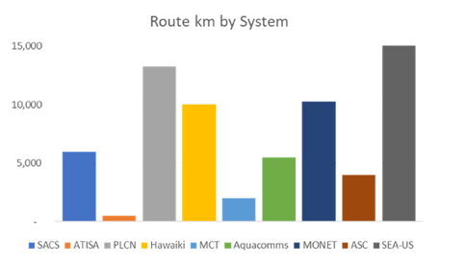
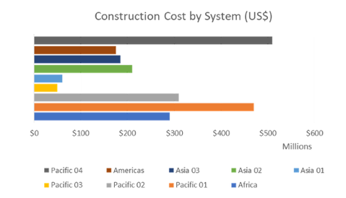
Our Impact: The Change we brought about
Route km achieving CIF and RFS with APTelecom support
Aggregate dollar value of successful system builds supported by us
APTelecom has supported systems in achieving their pre-sales objectives to reach CIF and RFS
APTelecom has helped its clients achieve CIF and RFS on a massive financial scale
66,507km, so far…
US$ 2,260 million, so far…
Copyright © 2024 APTelecom
Strictly Confidential

Slide 18


The Founders: Building a Better Connected World
Eric R Handa
Sean Bergin
CEO & CO-FOUNDER
PRESIDENT & CO-FOUNDER
Eric Handa, a telecom industry veteran, has transformed APTelecom from a startup into a global leader in fiber consulting. Launched in 2010, the company has secured over $450 million USD in sales for clients. Before founding APTelecom, Handa gained extensive experience in senior roles at major telecom companies such as AT&T and Bharti Airtel, across Asia, Europe, and the Middle East.
Handa's leadership expanded APTelecom's reach to every continent. He fosters a culture of giving back through the "State of Subsea" charity, supporting global non-profits. With extensive experience across Asia, Middle East, and Europe, Handa is a recognized expert on emerging markets for telecom
Under his leadership, APTelecom has expanded its reach and generated significant revenue through strategic consulting services. Bergin's expertise in emerging markets has contributed to the company's unique position in the industry. He has also been instrumental in APTelecom's charitable initiatives, such as the "State of Subsea" series.
With a strong track record in telecom management and a deep understanding of international markets, Bergin continues to be a driving force behind APTelecom's success. His leadership, coupled with his expertise in emerging markets, positions the company well for continued growth and innovation in the years to come.
Copyright © 2024 APTelecom
Strictly Confidential

Slide 19



Our Core Philosophy: Giving Back and Work Ethics
APTelecom believes in giving back to communities
We adhere to strict Work Ethics
We donate 10% of our profits to communities in the emerging markets in which we operate to support their sustainable growth and long-term stability.
These include a range of charitable organizations, including:
Bloom Again Foundation
Friends International
PTC Academy
APTelecom abides by the FCPA act and adheres to the highest standards of ethics and conduct.
We operate within the parameters of the US FCPA (1977) UK Bribery Act (2010), etc.
We are anti-corruption compliant
Copyright © 2024 APTelecom
Strictly Confidential

Slide 20

Some Projects in the past 12 months
1
2
3
4
BTI SUBSEA CABLE
INLIGO NETWORKS
ANDROMEDA SUBSEA CABLE
JAWS SUBSEA CABLE
Feasibility study
Technical:
Site surveys, vendor selection and design
Implementation
Commercial:
Business plan and demand forecast
International wholesale pre- sales
Commercial:
Due Diligence
Financial modelling, demand forecast and pricebook
International wholesale pre- sales
Debt/equity raise support
Commercial:
Financial modelling
Demand forecast
Pricebook development
Commercial:
Financial modelling
Demand forecast
Pricebook development
International wholesale pre- sales
Copyright © 2024 APTelecom
Strictly Confidential

Slide 21
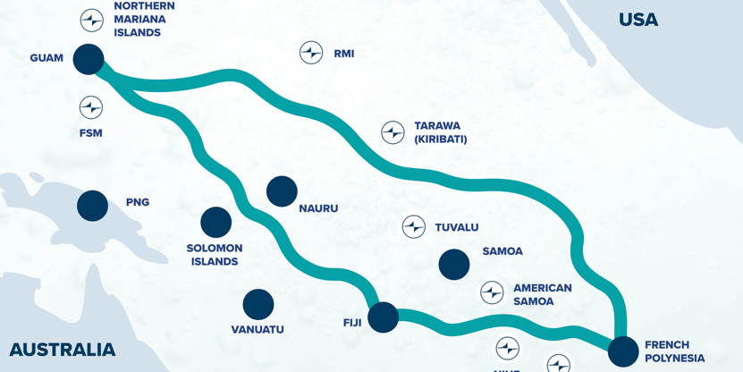
Our New Initiative: Central Pacific Cable
Proposed a new cable route connecting Guam to American Samoa—with spurs to poorly-served Pacific Island Countries (PICs):
Undertook a USTDA-funded feasibility study on behalf of Tuvalu Telecom
Project overbuild proposed by Google Inc, with cooperation from Australia’s Telstra Corporation
•The White House proposes cooperation to capitalize on private investment already planned in the same geography and category
APTelecom now working with US and Australian government agencies, including USTDA, to deliver a Google- and Telstra- underpinned solution that will still meet the needs of the poorly connected, remote populations of PICs
Copyright © 2024 APTelecom
Strictly Confidential

Slide 22


Our Investment Arm: APTProcure
APTProcure, the investment arm of APTelecom, was founded to identify and capitalize on key secular trends in subsea cable and edge data centers.
Superior Deal Flow: APTProcure identifies promising telecom infrastructure investments.
Deep Market Expertise: Extensive knowledge of industry trends.
Early-Stage Focus: Invests in early-stage ventures.
Unique Positioning: Spots opportunities and assesses entrepreneurs before competitors.
Rapid Action: Quickly evaluates investments and forms teams.
Proven Track Record: Successful history in nurturing telecom companies
UNEARTHING OPPORTUNITY
Copyright © 2024 APTelecom
Strictly Confidential

Slide 23


In Summary: The APTelecom Advantage
Expert Connectivity Consulting: APTelecom offers comprehensive consulting services to help businesses optimize their connectivity solutions.
Emerging Markets Focus: With extensive experience in developing markets, APTelecom is uniquely positioned to guide your company's growth.
Data Center Solutions: In addition to connectivity, APTelecom provides reliable data center services to ensure your business continuity.
Customizable Solutions: APTelecom goes beyond one-size-fits-all solutions, tailoring their services to meet your specific needs.
Unparalleled Expertise: Leverage APTelecom's deep industry knowledge and proven track record to achieve your connectivity goals.
Building a Stronger Future: Partner with APTelecom to build a robust and sustainable digital infrastructure for your business
Copyright © 2024 APTelecom
Strictly Confidential

Slide 24

JGJJBBJBJ
APTELECOM
Let's Connect and Elevate Your Digital Infrastructure
eric@aptelecom.com
sean@aptelecom.com

